Slide 1
Encapsulation
Object-Oriented Programming

Slide 2
Encapsulation
Encapsulation Concept
Access Modifier
Modularity
Package
Constructor

Slide 3
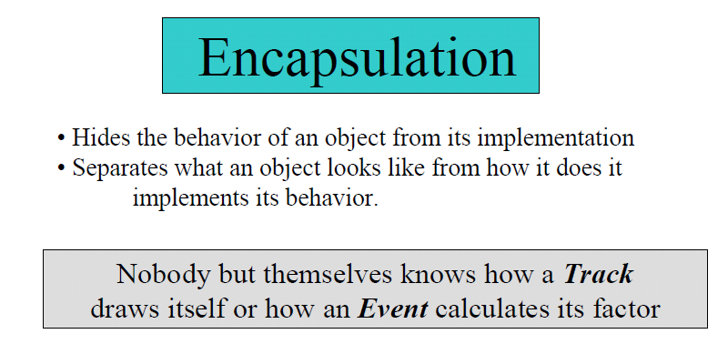

Slide 4

Encapsulation

Slide 5
Encapsulation
Modularity
The source code for an object can be written and maintained independently of the source code for the other objects
Data/Information Hiding
An object has public interface that other objects can use to communicate with it.
The object can maintain private information and method that can be changed at any time without affecting other objects that depend on it.

Slide 6
In other words…
Technique of making the fields in a class private and providing access to the field via public methods.
If a field is declared private, it cannot be accessed by anyone outside the class → data hiding
Prevents the code and data being randomly accessed by other code outside the class

Slide 7
public class Pizza {
private int topping; /*member field */
private String sauce;
public int getTopping(String user){
if (user.equals(“Andi”)){
return topping;
}
else return 999;
}
public void setTopping(int howMany) {
if(howMany < 3 ){
this.topping = howMany;
}
}
public String getSauce() {
return sauce;
}
public void setSauce(String somesSauce) {
this.sauce = someSauce;
}
}

Slide 8
/* File name : RunEncap.java */ public class RunEncap{ public static void main(String args[] ){ Pizza p = new Pizza();
p.setTopping(2);
System.out.println(“The topping on p is=“+p.getTopping(“Alex”));
Pizza q = new Pizza();
p.setTopping(4);
System.out.println(“The topping on q is=“+q.getTopping(“Andi”));
} }

Slide 9
Access modifier on class member (attribute & method)
public
protected
private
Default
Modifier | Same class | Same Package | Subclass | Any class
private | Y
default | Y | Y
protected | Y | Y | Y
Public | Y | Y | Y | Y

Slide 10
public
Fields, methods and constructors declared public (least restrictive) within a public class are visible to any class in the Java program, whether these classes are in the same package or in another package.

Slide 11
private
Fields, methods or constructors declared private are strictly controlled, which means they cannot be accessed by anywhere outside the enclosing class.
A standard design strategy is to make all fields private and provide public getter methods for them.

Slide 12
protected
Fields, methods and constructors declared protected in a superclass can be accessed only by subclasses in other/same packages.
Classes in the same package can also access protected fields and methods as well, even if they are not a subclass of the protected member’s class.

Slide 13
default
no access modifier is present.
Any class, field, method or constructor that has no declared access modifier is accessible only by classes in the same package.

Slide 14
Access modifier
In more clear explanations….

Slide 15

Access Modifiers
Access Modifiers specify what classes “see” or “know about”
methods or instance variables of other classes
They are the public, private, and protected
Effects of visibility … you cannot:
reference or instantiate classes which are “invisible” to you
call methods that are invisible to you
directly access instance variables which are invisible to you
but accessors (getter) and mutators (setter) permit safe access

Slide 16
private
Generally do not declare classes private
private methods:
invisible to all other classes
never inherited by subclasses
called implementation or helper methods because they are written for convenience and code reuse, but are never used outside of the class
private instance variables:
same visibility as private methods
generally, make every instance variable private
if other classes need to know about a class’s instance variables, use accessor and mutator methods (which are public)
private instance variables are pseudo-inherited – the subclass inherits them but can not access them directly
subclass benefits by using superclass’s methods that do have access to all instance variables declared at that level in the hierarchy
super class can provide accessors/mutators

Slide 17
protected
protected classes:
classes cannot be declared protected
protected methods:
are strictly visible to:
subclasses in this or other packages
other classes in same package
invisible to other packages (except subclasses)
protected instance variables:
same visibility as protected methods
protected instance variables are visible to:
all subclasses (regardless of package)
all classes in same package
avoid using protected instance variables, except when you want to give subclasses direct access
Generally preferable to use accessors and mutators (with private instance variables) than protected instance variables visible to the entire package

Slide 18
public
The public modifier means things are visible to all other classes
public classes:
visible to other classes in same package and visible to classes in other packages
good for reusing existing code
public classes generally go in their own file and filename must be the same as public class name.
generally, make every class public
exception is implementation or helper classes which you would never want other packages to know about and would never want to reuse - these are internal. We will see some of this later.
public methods:
visible to all classes that can see the class
inherited by subclasses
generally make every method public
exception is implementation or helper methods which you are writing for convenience and code reuse - these are for “internal use only”

Slide 19
CONSTRUCTOR

Slide 20
Constructor
Method that have the same name as the enclosing class and no return type specifier; public
The formal argument list of the constructor must match the actual argument list used in any new expression.

Slide 21
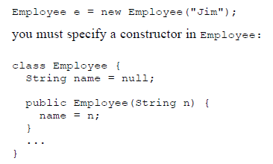
Example

Slide 22
Default Constructor
If a class does not define a constructor the compiler will provide a default constructor with no argument

Slide 23
Default Constructor
class Building {
private String address;
public void setAddress(String address) {
this.address = address;
}
public String getAddress() {
return this.address;
}
}
...........
Building x = new Building();
...........

Slide 24
Default Constructor
If the class is given new constructor, the default constructor can’t be used.

Slide 25
Constructor Overloading
We can make more than one constructor by overloaded it with another constructor with different parameter
In most situations, you will want to generate objects of a class from different sets of initial defining data.

Slide 26
Constructor Overloading
public class MyClass{
int x, y;
MyClass(){
System.out.println("Inside MyClass()");
x=0;
y=0;
}
MyClass(int i, int j){
System.out.println("Inside MyClass(int)");
x=i;
y=j;
}

Slide 27
Constructor Overloading
MyClass(MyClass obj){
System.out.println("Inside MyClass(MyClass)");
x=obj.x;
y=obj.y;
}
void getXYvalues(){
System.out.println("The value are "+x+","+y);
}
}

Slide 28

Modularity

Slide 29
Modularity
Aspect of syntactically grouping related declarations. (E.g., fields and methods of a data type.)
Module in Modula-2, Class/file in C++.
Package/class in Java.
In OOPLs, a class serves as the basic unit for decomposition and modification. It can be separately compiled.
Notes:
Other Examples: Laptops and desktop PCs exemplify modular designs.

Slide 30
access modifier on class
default
public

Slide 31
default
package satu;
class Animal {}
package dua;
import satu.Animal;
class Dog extends Animal {}
→ Akan muncul error ketika kelas Dog dikompilasi, karena kelas Animal mempunyai akses default dan terletak pada package yg berbeda

Slide 32
public
package satu;
public class Animal {}
→kelas Animal dapat diinstasiasi dan di-extends oleh kelas lain

Slide 33
Package and Directory Hierarchy

Slide 34
Package
Packages are used in Java in-order to prevent naming conflicts, to control access, to make searching/locating and usage of classes, interfaces, enumerations and annotations easier etc.
A Package can be defined as a grouping of related types(classes, interfaces, enumerations and annotations ) providing access protection and name space management.

Slide 35
The package statement should be the first line in the source file. There can be only one package statement in each source file, and it applies to all types in the file.
If a package statement is not used then the class, interfaces, enumerations, and annotation types will be put into an unnamed package.

Slide 36
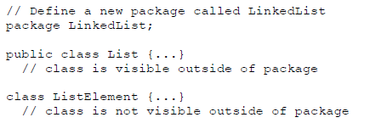

List.java
A.java
See next slide for the explanation

Slide 37
Class List → visible to classes outside package LinkedList
Class A may not access ListElement because class A in different package
Class A may acess Class List from different package by import the class inside the LinkedList package

Slide 38
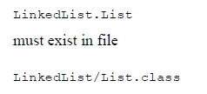
Directory Structure of Package
The name of the package becomes a part of the name of the class
The name of the package must match the directory structure where the corresponding bytecode resides.

Slide 39
References
Beginning Java 2, Ivor Horton
Booch
Browns Univ
Some picture & code from internet

